Slide 1
ARM – assembly language programming

Slide 2
Agenda
Basic Structure
Assembler Directives in ARM
Sample Programs

Slide 3
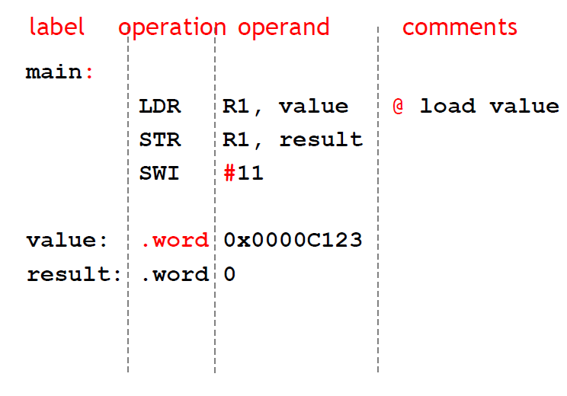
General structure

Slide 4
Assembler directives in arm v4
TTL – Stands for title, optional
AREA – Specifies an area
Parameters - a {name}, type {CODE/DATA} and accessibility status [READONLY, READWRITE etc.]
Define Data
DCB – Define Byte
DCW – Define Word
DCD – Define Constant Data (Half-word aligned)
ALIGN – to word –align data
EQU – to equate a name with data/address
ENTRY and END

Slide 5
General points
Every program needs an area for CODE, which is usually READONLY
The executable code is written between ‘ENTRY’ and ‘END’
For a program with single function, the first statement can be prefixed with the label Main
Usually the last statement before ‘END’ will be either ‘STOP B STOP’ or ‘SWI &11’
When you try modifying DCD/DCB/DCW areas, you may get an error as the code area is READONLY.
; represents a comment
# is used to indicate a constant

Slide 6
Arithmetic operations
AREA qn1,CODE, READONLY
ENTRY
Main MOV R0, #5 ; R0 = 5
MOV R1, #10; R1 = 10 /0xA
ADD R2, R0,R1; R2 = R0+R1 (0xF)
SUB R3, R0,R1; R3 = R0-R1 (-5)
RSB R4,R0,R1 ; R4 = R1-R0 (5)
SUBS R3, R0,R1 ; See the difference in CPSR
Stop B Stop ; can be repl;aced by SWI &11
END

Slide 7
steps to see results using keil v4
Create a new project (Project → New Project → Give name)
Select device as ‘LPC2148’
Give ‘No’ for ‘ Copy ‘startup.s’ to Project Folder ?’ dialogue box
Create a new .s file (File → New → Save the file with .s extension (file type should be all files)
Write the code. Indentation/Spacing is very important.
Save all files and Build all files
Go to debug mode
Execute – either completely or go step-by-step

Slide 8
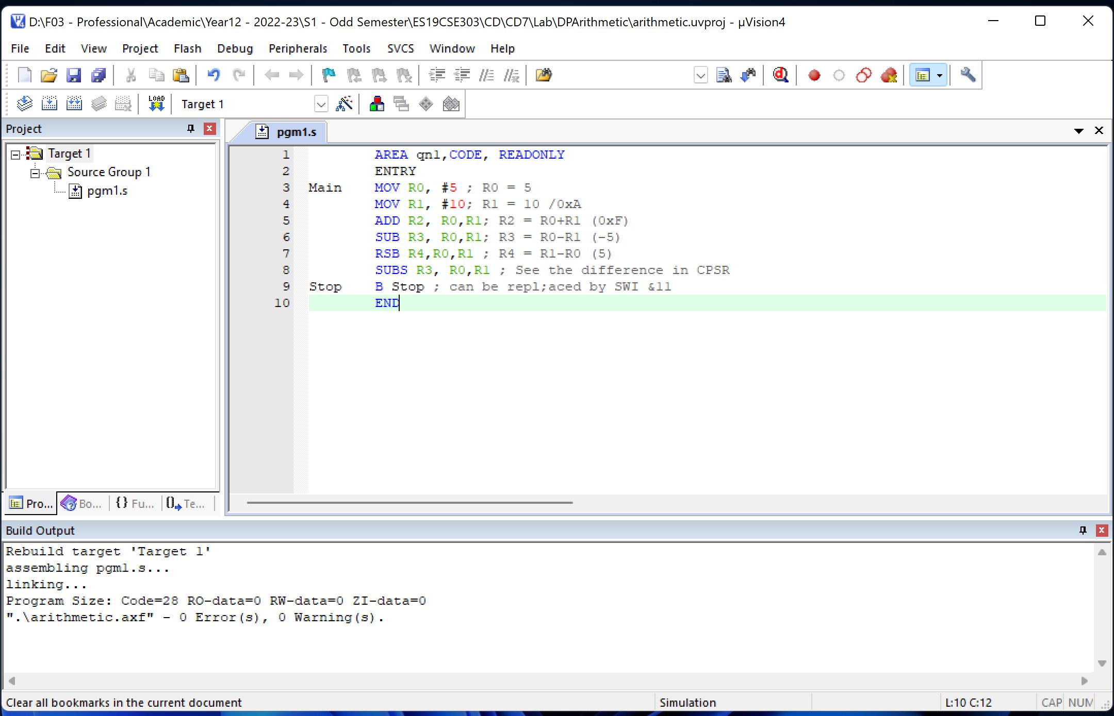
After doing till step 6

Slide 9
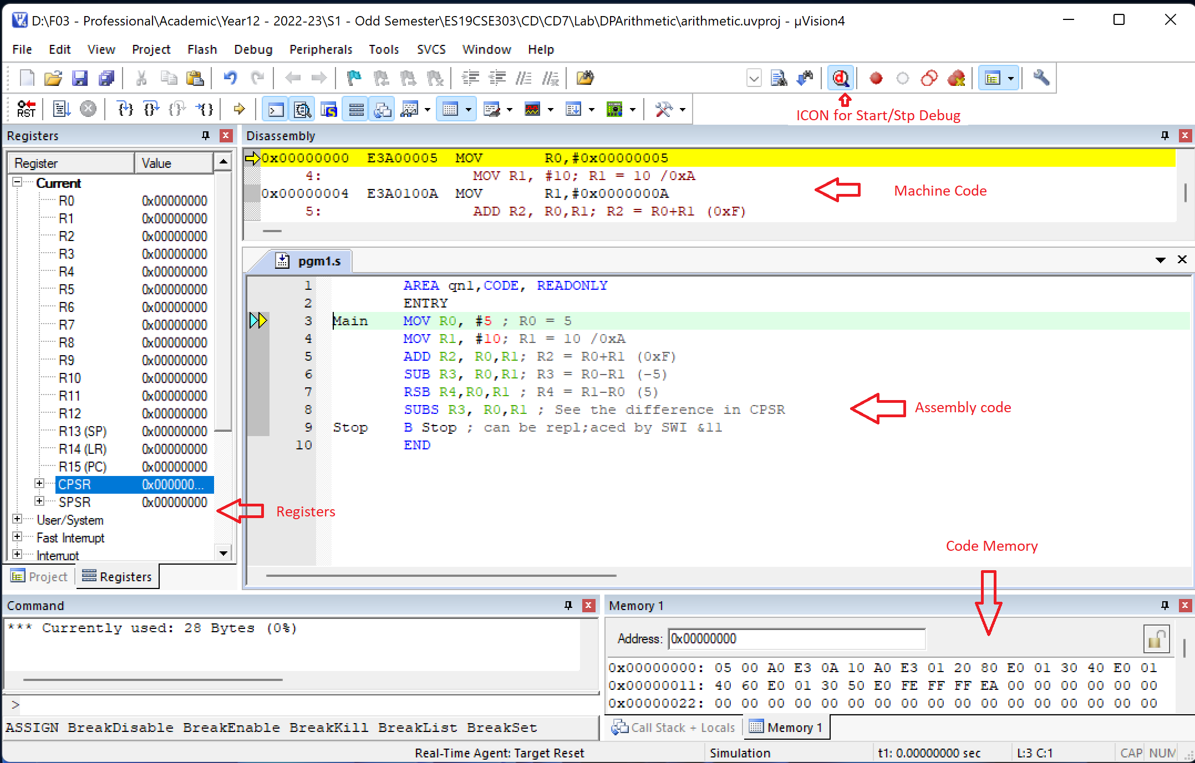
Step 7

Slide 10
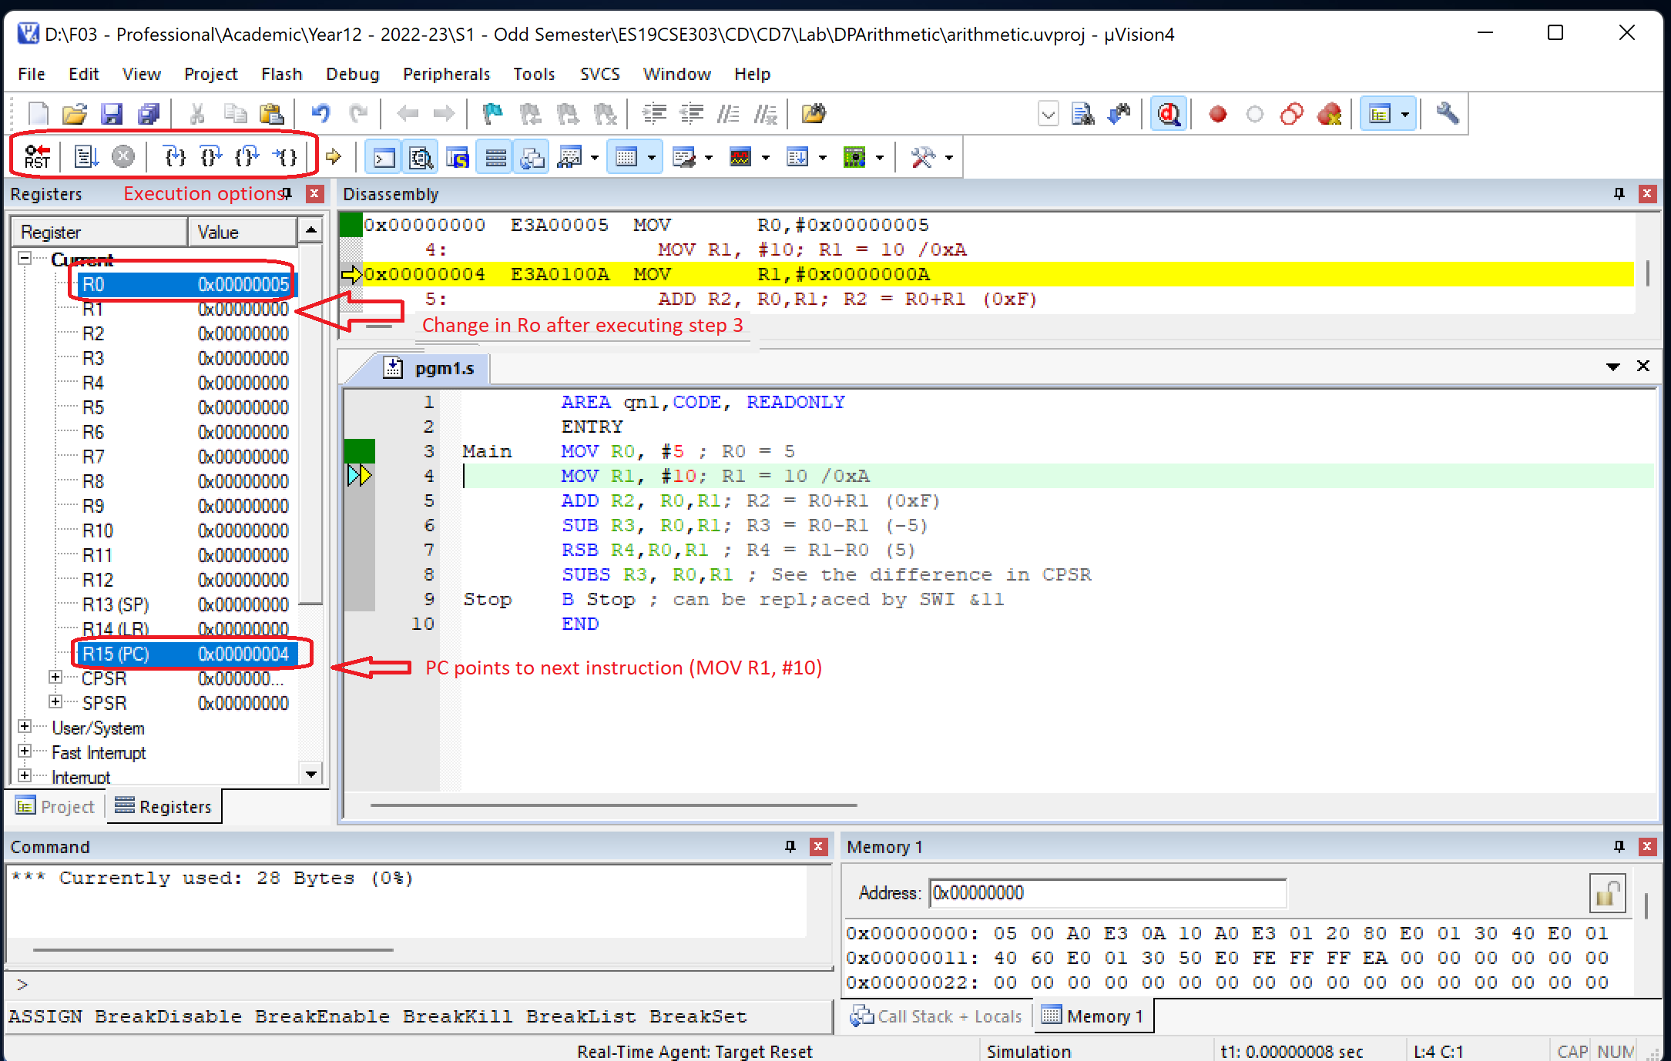
Step 8 – Executing first instruction

Slide 11
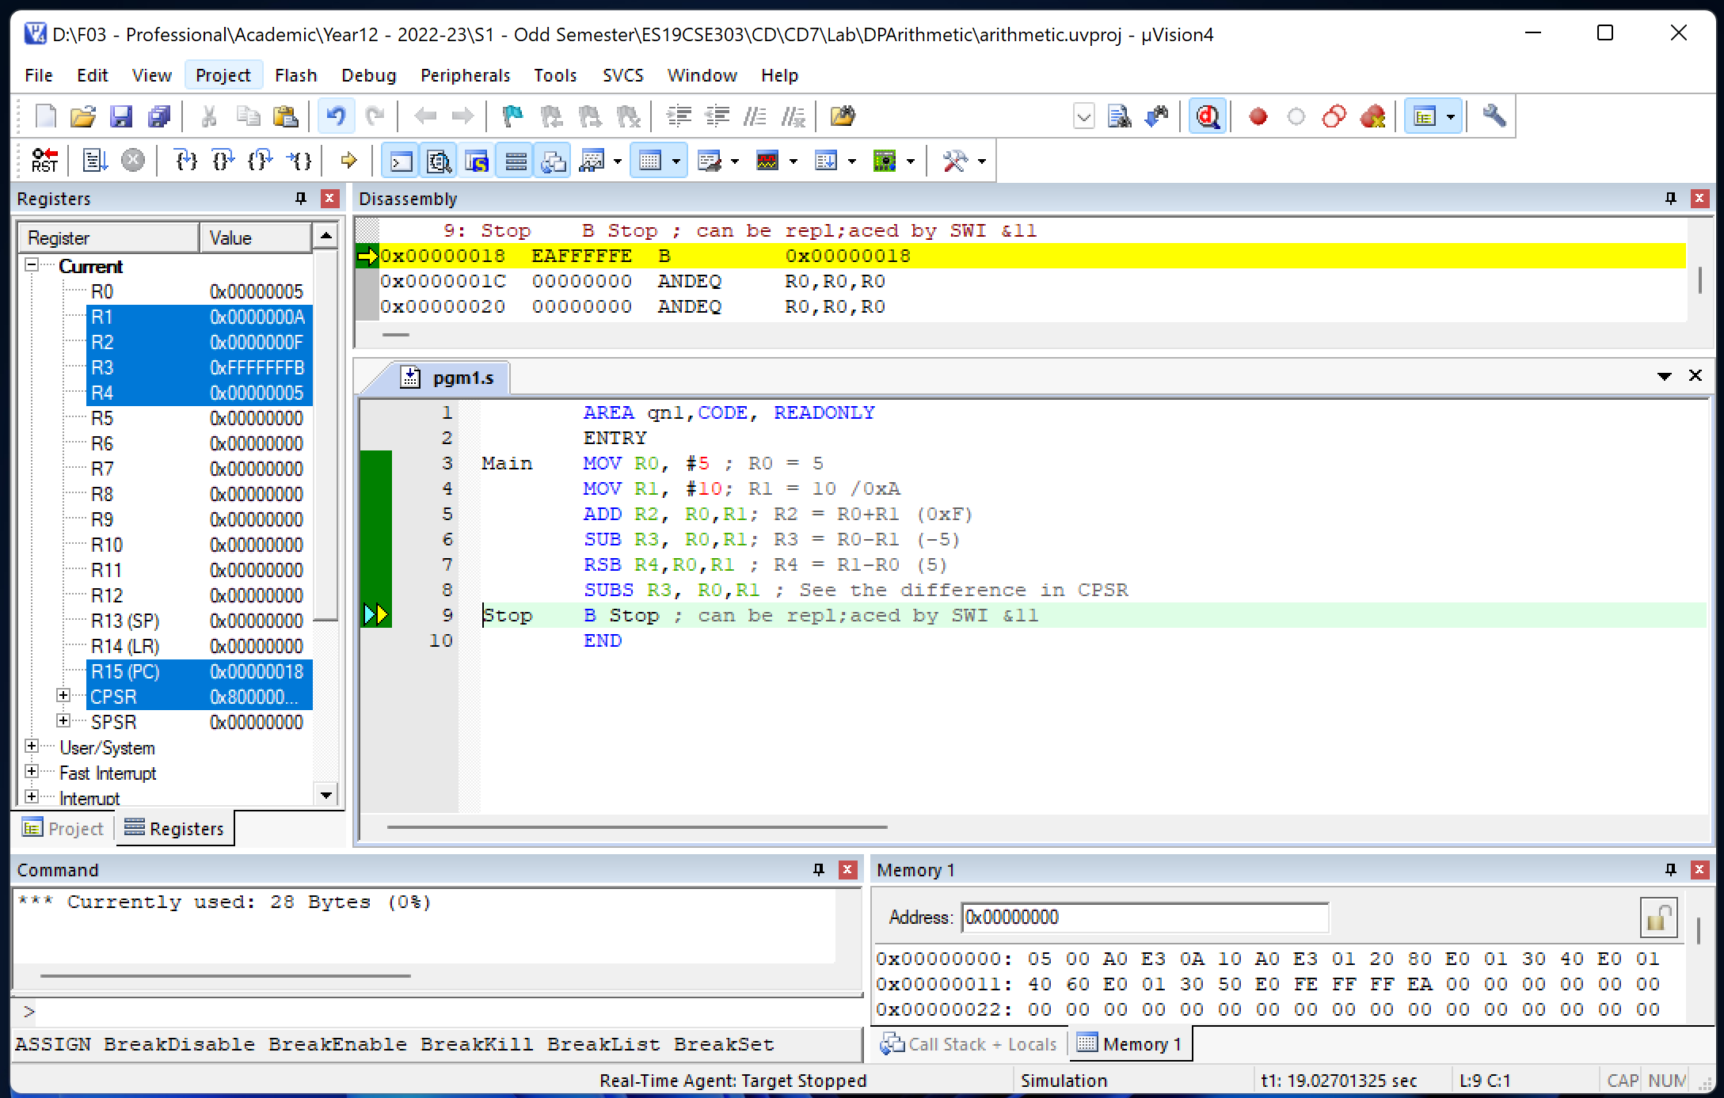
After finishing the execution – getting stuck at ‘stop b stop’ !!!

Slide 12
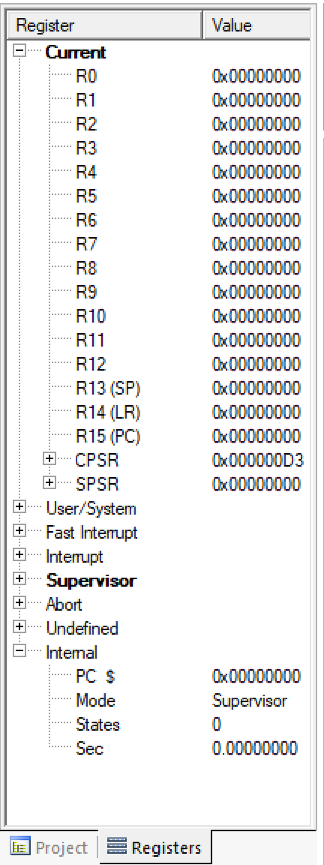
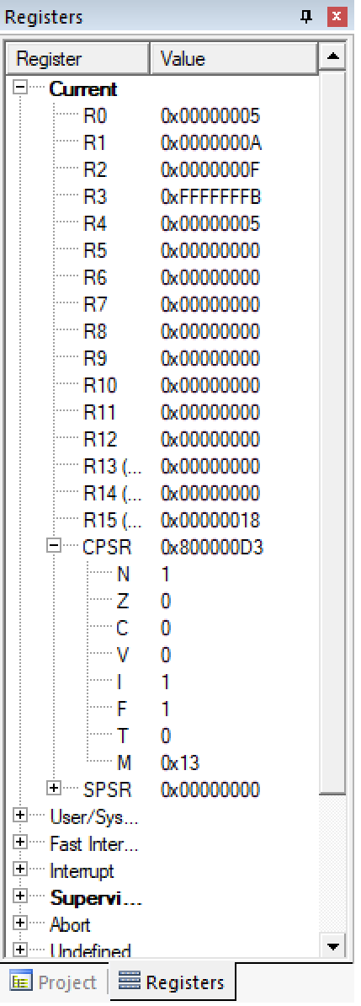
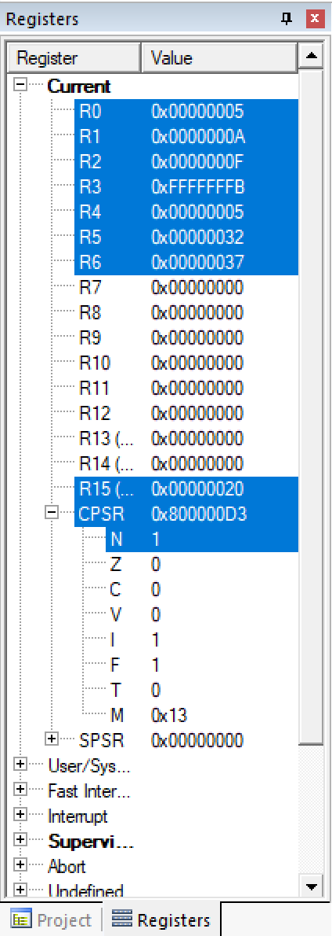
Arithmetic operations with multiplication
AREA qn1,CODE, READONLY
ENTRY
Main MOV R0, #5 ; R0 = 5
MOV R1, #10; R1 = 10 /0xA
ADD R2, R0,R1; R2 = R0+R1 (0xF)
SUB R3, R0,R1; R3 = R0-R1 (-5)
RSB R4,R0,R1 ; R4 = R1-R0 (5)
SUBS R3, R0,R1 ; See the difference in CPSR
MUL R5,R0,R1 ; R5 = R0 * R1 = 50 (0x32)
MLA R6,R0,R1,R0; R6 = 55 (0x37)
Stop B Stop ; can be repl;aced by SWI &11
END
Starting State
Before MUL
Execution Ended

Slide 13
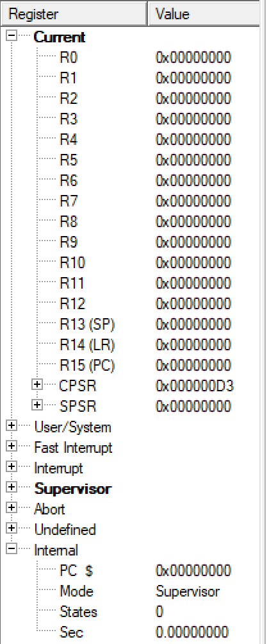
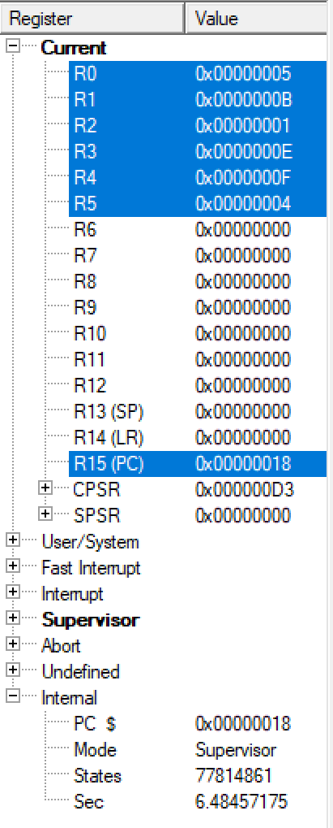
logical operations
AREA qn1,CODE, READONLY
ENTRY
Main MOV R0, #5
MOV R1, #11
AND R2, R0,R1; R2 = 5 & 11 = 1
EOR R3, R0,R1; R3 = 5 XOR 11 = 0xE
ORR R4,R0,R1 ; R4 = 5 OR 11 = 0xF
BIC R5, R0,R1 ; Performs (5) & not(11) = 0x4
;(NOT (11) = 0xFFFF FFF4
; NOT(11) & 5 = 0x0000 0004)
Stop B Stop ; can be replaced by SWI &11
END
Before Execution
After Execution

Slide 14
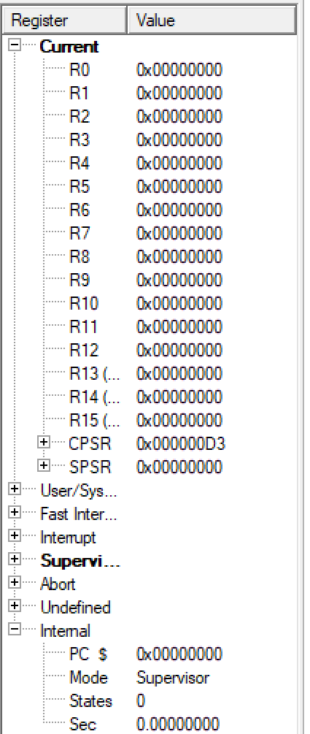
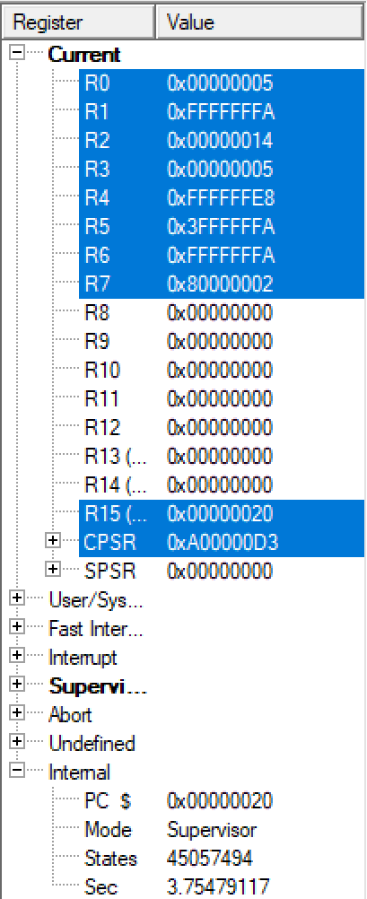
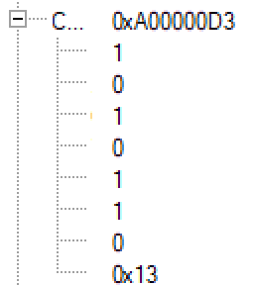
Data movement with barrel shifter operations
AREA qn1,CODE, READONLY
ENTRY
Main MOV R0, #5 ; R0 = 5
MVN R1,R0 ; R1 = -(5) in 1's complement form -flipping of bits
MOV R2, R0, LSL #2;R2 = R0 * 4 = 20 (Ox14)
MOV R3, R2, LSR #2; R3 = R2/4 = 20/4=5
MOV R4, R1, LSL #2 ; R4 = R1*4
MOV R5, R4, LSR #2 ; MSB filled by 0s
MOV R6, R4, ASR #2;MSB filled by sign bit - 0 for +ve numbers and 1 for -ve numbers
MOVS R7, R0, ROR #1;LSb becomes MSb
Stop B Stop ; can be replaced by SWI &11
END
Before Execution
After Execution

Slide 15
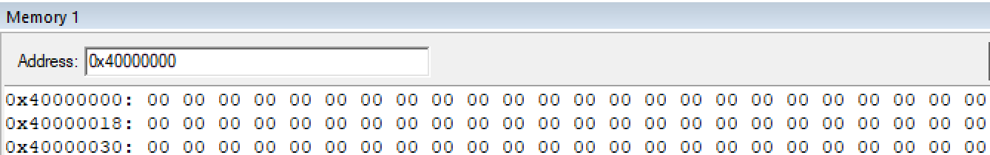
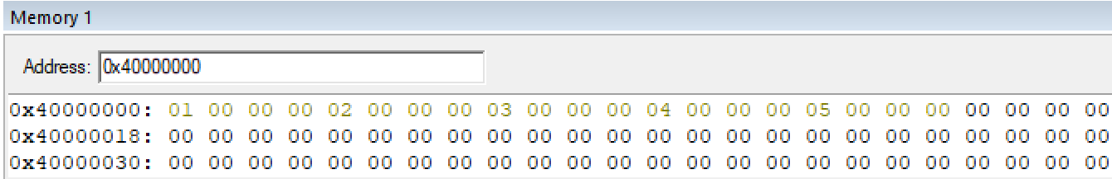
Store data in memory – STR with BRANCH
Qn. Initialize an array of size 5 with numbers from 1 to 5
AREA qn1,CODE, READONLY
ENTRY
Main LDR R1,=0x40000000
; Base address of Array 0x4000 0000 is the location from which data can be written
MOV R2,#0
MOV R3, #5;Number of elements to be stored/ Size of Array
LOOP CMP R2,R3 ; Checking whether index has reached the limit
BGE Stop ; if index >= size, stop
ADD R4, R2,#1 ; R4 = R2+1
STR R4, [R1],#4
; storing R4 value into memory pointed by R1 and update R1 as R1+4
ADD R2, R2,#1 ; update R2 as R2+1
BNE LOOP; Repeat search if item is not found yet
Stop B Stop
END
Data Memory before execution
Data Memory after execution

Slide 16
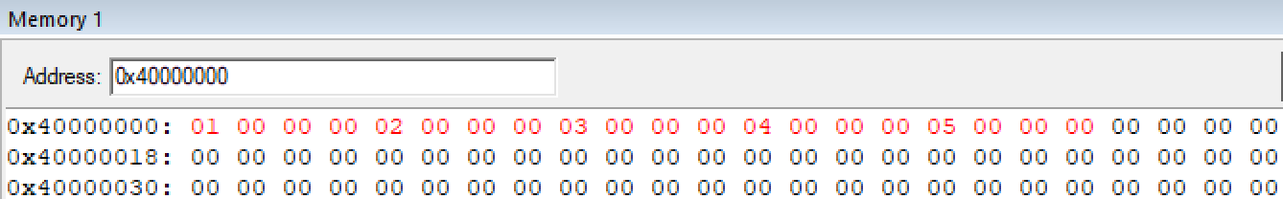
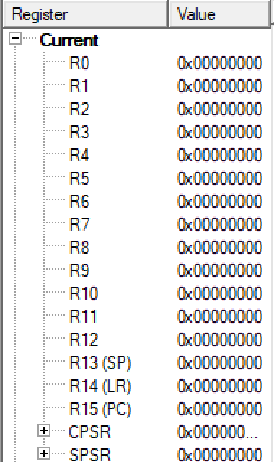
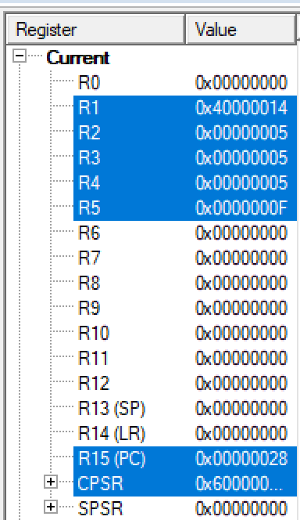
Load data from memory
Before Execution – Initial Array
After Execution – All elements accessed
Qn. Find the sum of array elements
AREA qn1,CODE, READONLY
ENTRY
Main LDR R1,=0x40000000
MOV R2,#0 ;register for array index
MOV R3, #5;Number of elements to be stored/ Size of Array
MOV R5,#0 ;register for array sum
LOOP CMP R2,R3 ; Checking whether index has reached the limit
BGE Stop ; if index >= size, stop
LDR R4, [R1],#4 ; Fetch MEM[R1] to R4; update R1 as R1+4
ADD R5,R5,R4 ; sum of array elements
ADD R2, R2,#1 ; update R2 as R2+1
BNE LOOP; Repeat search if item is not found yet
Stop B Stop
END
Registers –Initial values
Registers – Final Values

